Slide 1
MS Capstone
Tufts University
Kevin Ortiz

Slide 2
Overview

Slide 3
Idea
Millions of people have immigrated to the United States and the census has captured information about a lot of them.
What if there was one “person”, let’s call them Oracle, who remembered the information of every single immigrant; when they first came and their life afterward. Then if a new person immigrates, Oracle can search their memory for previous immigrants who were similar to the new person.
This would enable Oracle to give personalized guidance to the new immigrant. Capitalizing on learned patterns of those who have come before.

Slide 4
Data Limitations
Census data is anonymized, we can’t follow a specific individual over time.
Census data depends on the willingness of the individual to give it. There were a lot of NaN values that had to be accounted for.

Slide 5
Methodology

Slide 6
Reinforcement Learning
I defined success as income, Oracle would provide personalized guidance as to what characteristics of your census profile you could change to increase your income.
As I fed Oracle each profile, one by one, I wanted it to remember which profiles indicated a certain level of income, this required a classifier to predict what income level a profile would fall under
  There were 109 different variables provided by the census. I constrained by profile characteristics to these 22:
  [STATEFIP, METRO, OWNERSHPD, MORTGAGE, NCHILD, SEX, AGE, MARST,
  RACE, HISPAN, BPL, CITIZEN, YRSUSA1, LANGUAGE, SPEAKENG, SCHOOL,
  EDUC, EMPSTAT, OCC, UHRSWORK, TRANWORK, CARPOOL]
  I constrained my classifier output to 4 income brackets: Tier 1 (lowest), Tier 2, Tier 3, Tier 4 (highest)
Notes:
How I decided on those 22 characteristics
From the initial 109, I discarded all the ones that:
Didn’t relate to income, such as IDs specific to the census report
Weren’t actionable/defining characteristics of a person
Had too many NaN values
Then I trained my classifier model on different combinations of characteristics and saved the ones that gave me the highest accuracy scores

Slide 7
Classifier
Since I had several characteristics and millions of data points, I tried fitting my data to models that were adept at handling high-dimensional data. I tried and tuned the following:
  Histogram-based Gradient Boosting Classification Tree
  Multi-layer Perceptron Classifier
  Random Forest Classifier
Best classifier: Random Forest
  Training Accuracy: 99.4%
  Test Accuracy: 78.5%
Notes:
Histogram-based Gradient Boosting Classification Tree
This estimator has native support for missing values (NaNs)
Adept at handling large data sets
Training Accuracy: 79.3%
Test Accuracy: 79.3%
Multi-layer Perceptron
Training Accuracy: 70.4%
Test Accuracy: 70.4%
Random Forest Classifier
Training Accuracy: 99.4%
Test Accuracy: 78.5%

Slide 8
Classifier Continued
 |  | Classifier output
 |  | Tier 1 | Tier 2 | Tier 3 | Tier 4
 | Tier 1 | 850577 | 60622 | 3470 | 5956
Ground | Tier 2 | 98908 | 172631 | 13970 | 16749
Turth | Tier 3 | 17645 | 37673 | 42808 | 25324
 | Tier 4 | 11057 | 19371 | 11479 | 109998
Confusion Matrix – Test Data:
Accuracy Analysis:
True Positive Rate
overall accuracy | 0.78493137
Tier 1 acc | 0.92391256
Tier 2 acc | 0.5711379
Tier 3 acc | 0.34676387
Tier 4 acc | 0.72412363
False positive rate
Tier 1 | 0.28167056
Tier 2 | 0.10496062
Tier 3 | 0.02488459
Tier 4 | 0.04311226

Slide 9
Classifier Continued
examples labeled Tier 1 are actually Tier 1 | 0.86954437
examples labeled Tier 1 are actually Tier 2 | 0.10111359
examples labeled Tier 1 are actually Tier 3 | 0.01803847
examples labeled Tier 1 are actually Tier 4 | 0.01130356
examples labeled Tier 3 are actually Tier 1 | 0.04837788
examples labeled Tier 3 are actually Tier 2 | 0.19476627
examples labeled Tier 3 are actually Tier 3 | 0.59681849
examples labeled Tier 3 are actually Tier 4 | 0.16003736
Predictive Values:
To account for uncertainty, whenever my classifier predicted a Tier, I’d generate a random number and depending on where it fell in the above probability ranges, that would be the final predicted Tier
examples labeled Tier 2 are actually Tier 1 | 0.20882751
examples labeled Tier 2 are actually Tier 2 | 0.59467029
examples labeled Tier 2 are actually Tier 3 | 0.12977399
examples labeled Tier 2 are actually Tier 4 | 0.06672821
examples labeled Tier 4 are actually Tier 1 | 0.03768976
examples labeled Tier 4 are actually Tier 2 | 0.10598822
examples labeled Tier 4 are actually Tier 3 | 0.1602511
examples labeled Tier 4 are actually Tier 4 | 0.69607092

Slide 10
Grid World
profile = ["STATEFIP", "METRO", "OWNERSHPD", "MORTGAGE", "NCHILD", "SEX", "AGE", "MARST", "RACE", "HISPAN", "BPL", "CITIZEN", "YRSUSA1", "LANGUAGE", "SPEAKENG", "SCHOOL", "EDUC", "EMPSTAT", "OCC", "UHRSWORK", "TRANWORK", "CARPOOL"]
  22 characteristics
The above is a representation of a coordinate, a point in space of my grid world.
By changing the value of each characteristic, my agent can “move” through this world. Given the training data, I imagined a world where certain areas of it were defined by low/high incomes and everything in between.
The goal was for my agent to learn which characteristics to change and what values to change them to, which would lead the agent to a higher income space.

Slide 11
Reinforcement Learning Continued
State Space
  Size: 9266013904752000000000 or 9.26e21 possibilities
  This was after data engineering a couple variables and constraining my space via available actions. The original was on the order of 10^28.
Available Actions
  I limited what actions could be taken given your current state.
  Ex) You could ”move” education by one year. If you’re at a high school level, you can’t jump to a PhD
  Some characteristics were not constrained at all such as STATE, you could choose to move to any state, whenever
  Some characteristics weren’t considered, such as Birthplace or Race, those would stay the same throughout a person/RL agent’s journey
Notes:
DATA ENGINEERING
uhrswork_trans = pd.cut(X["UHRSWORK"], bins=[-9999999, 10, 20, 30, 40, 50, 60, 70, 80, 90, 1000], labels=[10, 20, 30, 40, 50, 60, 70, 80, 90, 100])
occ_trans = pd.cut(X["OCC"], bins=[-999999, 1, 961, 1981, 2971, 3551, 4656, 5941, 7641, 9761, 9831, 9921], labels=[0, 960, 1980, 2970, 3550, 4655, 5940, 7640, 9760, 9830, 9920])

Slide 12
Reinforcement Learning Continued
Reward Function
  Used regular Q-learning for my updates
    q_table[state][action] += learning_rate * (reward + discount_factor * q_table[next_state][max_action] - q_table[state][action])
  Decided on dense rewards
    Wanted the agent to be rewarded for moving up in income level, not just getting to the highest income.
    To encourage it to reach for the top, I increased the reward amount in the higher income tiers, so it would learn to strive to be in the higher income space
  Positive rewards were only given when the next_state was deemed as higher income than the previous state. If an action brought a state to the next higher Tier, I would include a bonus in the reward as well. But I needed a way to differentiate income level for states in the same Tier.
Notes:
Reward Points
Tier 1: 50
Tier 2: 100
Tier 3: 150
Tier 4: 200
Bonus for moving up a tier: 500

Slide 13
Reinforcement Learning Continued
Reward function
  I used the predict_prob function of my model to compare income levels of states
    If next_state had a larger probability than current_state, I would return a positive reward for that action.
      Depending on the current_state, I would use the probability of being in Tier 3 or 4
    If the probabilities were the same, reward would be 1
    If next_state’s probability was lower, that would mean the action taken brought the agent farther from the higher income space, therefore I’d return a negative reward
Notes:
Probabilities being the same: 0 reward allowed it to go in loops and didn’t make it clear that this state was visited. The initial value of all states was 0.

Slide 14
Testing

Slide 15
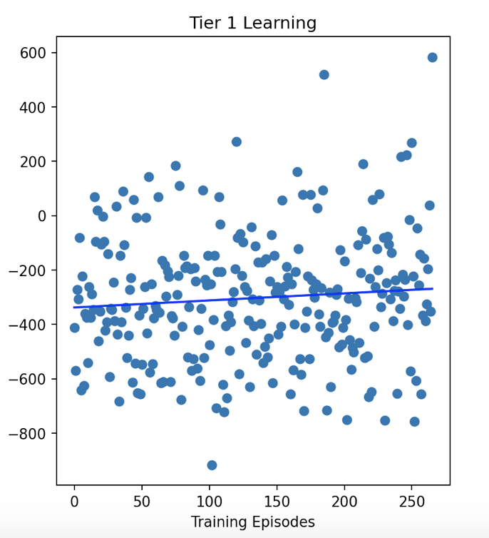
Tier 1 Learning
Best fit line shows a positive slope showing that the average accumulated reward is increasing during training
  Slope: 0.26
Naïve Run Average Reward: -72
Greedy Runs Average Rewards
  V1: 998
  V3: 502
  V6: 1697
Greedy Runs Average Tier 1 Mix
  V1: -316
  V3: -365
  V6: -3
Average Reward
Notes:
Tier 4 had a higher slope which indicates that the agent was better able to find actions that gave it more positive rewards in Tier 4 as compared to Tier 1. This could be an indicator of how it is more difficult to increase your income if you start low. It takes money to make money.
It makes sense that my average reward is higher when starting in Tier 4 because the rewards in that tier are inherently higher but was is interesting is that for Tier 1, our average rewards are not only smaller but negative. This could indicate that not only is it harder to increase your income starting in Tier 1, but there are also a lot of actions that would produce negative rewards and not just even keel ones. It could also indicate that it’s more frequent to raise a tier and than fall back down to a lower one, as compared to tier movement happening in Tier 4.

Slide 16
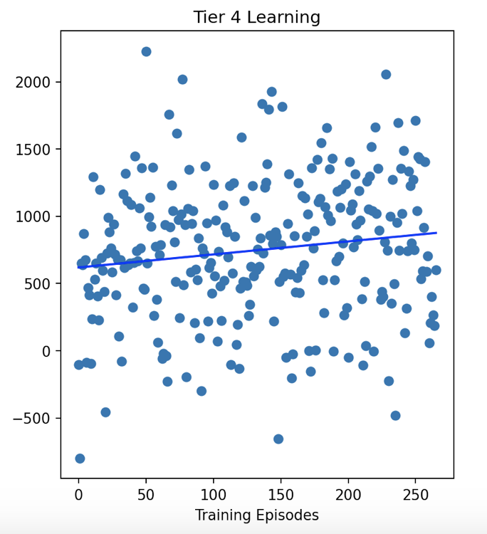
Tier 4 Learning
Best fit line shows a positive slope showing that the average accumulated reward is increasing during training
  Slope: 0.97
Naïve Run Average Reward: -789
Greedy Runs Average Rewards
  V1: 1321
  V3: 2102
  V6: 2530
Greedy Runs Average Tier 4 Mix
  V1: 174
  V3: 295
  V6: 713
Average Reward
Notes:
Average every 10 accumulated rewards.
Tier 4 had a higher slope which indicates that the agent was better able to find actions that gave it more positive rewards in Tier 4 as compared to Tier 1. This could be an indicator of how it is more difficult to increase your income if you start low. It takes money to make money.
It makes sense that my average reward is higher when starting in Tier 4 because the rewards in that tier are inherently higher but was is interesting is that for Tier 1, our average rewards are not only smaller but negative. This could indicate that not only is it harder to increase your income starting in Tier 1, but there are also a lot of actions that would produce negative rewards and not just even keel ones. It could also indicate that it’s more frequent to raise a tier and than fall back down to a lower one, as compared to tier movement happening in Tier 4.

Slide 17
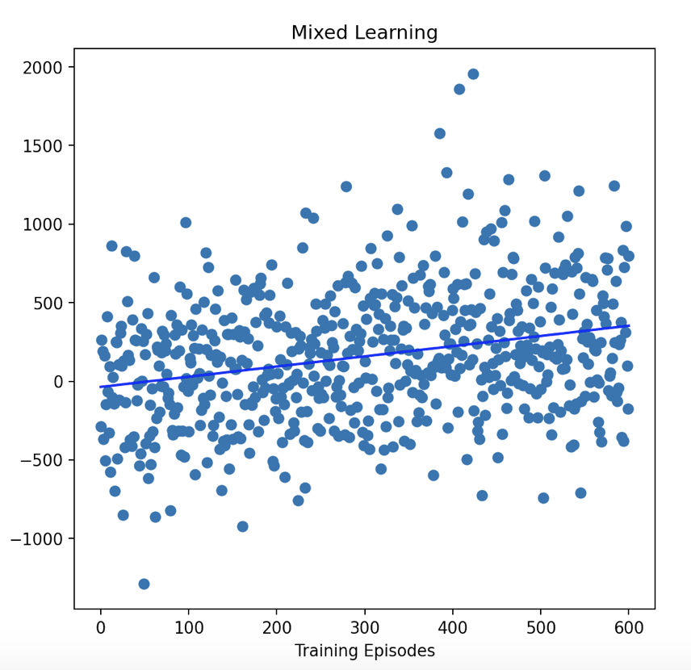
Mixed Learning
Best fit line shows a positive slope showing that the average accumulated reward is increasing during training
  Slope: 0.65
Naïve Run Average Reward: -252
Greedy Runs Average Rewards
  V1: 1511
  V2: 1734
Average Reward
Notes:
Mixed was using 20 different starting states. 5 from each Tier.
Mixed slope is almost halfway between the slops of Tier 1 and Tier 4

Slide 18
Results

Slide 19
Tier 1
 | STATEFIP | METRO | OWNERSHPD | MORTGAGE | NCHILD | SEX | AGE | MARST | RACE
FIRST: | California | Mixed | Own w/ mortgage | Have mortgage | X | X | X | Single | X
SECOND: | Hawaii, Ohio, South Dakota | Not in metro area | Own free and clear | Own free and clear | X | X | X | Married | X
 | HISPAN | BPL | CITIZEN | YRSUSA1 | LANGUAGE | SPEAKENG | SCHOOL | EDUC | EMPSTAT
FIRST: | X | X | Born | X | Arabic | No English | In School | 1 year, college | Not in labor force
SECOND: | X | X | Naturalized | X | Chinese | Speaks well |  | High school | Employed
 | OCC | UHRSWORK | TRANWORK | CARPOOL
FIRST: | Healthcare | 50 | N/A | Carpools
SECOND: | ELAM | 80 | N/A | Drives others
Notes:
ELAM - Education, legal, arts and media
RED
CITIZEN. Agent learned to recommend to be born a citizen, would have to account for that.
TRANWORK. Agent learned to not change this at all, not sure if it deemed it not important or what.
EMPSTAT. Agent learned that the best option is to not be in the labor force. Seems wrong…maybe that means they’re getting benefits?

Slide 20
Tier 4
 | STATEFIP | METRO | OWNERSHPD | MORTGAGE | NCHILD | SEX | AGE | MARST | RACE
FIRST: | Virginia, DC, Rhode Island | Suburb | Own / mortgage | Have mortgage | X | X | X | Married | X
SECOND: | WV, NC, MA, KS, GA, MI | Mixed | Own free and clear | Own free and clear | X | X | X | Divorced | X
 | HISPAN | BPL | CITIZEN | YRSUSA1 | LANGUAGE | SPEAKENG | SCHOOL | EDUC | EMPSTAT
FIRST: | X | X | Naturalized | X | French | Speaks very well | Not in school | 5+ years, college | Employed
SECOND: | X | X |  | X | Arabic, Italian | Speaks but not well |  | 4 years, college
 | OCC | UHRSWORK | TRANWORK | CARPOOL
FIRST: | Comp, Eng, Sci | 50 | Auto | Drives alone
SECOND: | Healthcare | 60 |  | Carpools

Slide 21
Mixed
 | STATEFIP | METRO | OWNERSHPD | MORTGAGE | NCHILD | SEX | AGE | MARST | RACE
FIRST: | Minnesota | Suburb | Own w/ mortgage | Have mortgage | X | X | X | Married | X
SECOND: | Montana, Oklahoma | Mixed, Metro | Own free and clear | Own free and clear | X | X | X | Divorced | X
 | HISPAN | BPL | CITIZEN | YRSUSA1 | LANGUAGE | SPEAKENG | SCHOOL | EDUC | EMPSTAT
FIRST: | X | X | Naturalized | X | German | Speaks very well | Not in school | 5+ years, college | Employed
SECOND: | X | X | Not a citizen | X | Chinese, English | Speaks but not well |  | 2 years, college
 | OCC | UHRSWORK | TRANWORK | CARPOOL
FIRST: | Management, Business, Financial | 70 | Auto | Drives alone
SECOND: | Service | 60 |  | Carpools
Notes:
ELAM - Education, legal, arts and media
RED
CITIZEN. Agent learned to recommend to be born a citizen, would have to account for that.
TRANWORK. Agent learned to not change this at all, not sure if it deemed it not important or what.
EMPSTAT. Agent learned that the best option is to not be in the labor force. Seems wrong…maybe that means they’re getting benefits?

Slide 22
Guidance – Tier 1
Start: [6, 2, 0, 0, 0, 2, 84, 4, 1, 0, 457, 3, 45, 23, 6, 1, 2, 3, 0, 10, 0, 0]
[6, 2, 0, 0, 0, 2, 84, 4, 1, 0, 457, 2, 45, 23, 6, 1, 2, 3, 0, 10, 0, 0]
  CITIZEN → 2 (Naturalized). 3% increase of moving to Tier 2.
[6, 2, 0, 0, 0, 2, 84, 4, 1, 0, 457, 2, 45, 57, 6, 1, 2, 3, 0, 10, 0, 0]
  LANGUAGE → 57 (Arabic). 2% increase of moving to Tier 2.
[6, 2, 0, 0, 0, 2, 84, 4, 1, 0, 457, 2, 45, 57, 6, 1, 7, 3, 0, 10, 0, 0]
  EDUC → 7 (1 year of college). 4% increase for Tier 2. 2% increase for Tier 3.
End: [6, 2, 0, 0, 0, 2, 84, 4, 1, 0, 457, 2, 45, 57, 6, 1, 7, 3, 3550, 50, 0, 2]
  OCC → 3550 (Healthcare). UHRSWORK → 50. CARPOOL → 2 (Carpools).
  27% increase for Tier 2. 24% increase for Tier 3.
Notes:
Start state probability: [0.98 0.02 0. 0. ]
[0.95 0.05 0. 0. ]
[0.96 0.04 0. 0. ]
[0.9 0.06 0.02 0.02]
End state probability: [0.315 0.285 0.24 0.16 ]

Slide 23
Guidance – Tier 4
Start: [53, 3, 13, 3, 2, 1, 35, 1, 6, 0, 521, 3, 10, 40, 5, 1, 11, 1, 1980, 40, 10, 2]
[53, 3, 13, 3, 2, 1, 35, 1, 6, 0, 521, 2, 10, 11, 5, 1, 11, 1, 1980, 40, 10, 2]
  CITIZEN → (Naturalized). LANGUAGE → 11 (French).
  49% decrease for Tier 4. 25% increase for Tier 3.
[53, 3, 13, 3, 2, 1, 35, 1, 6, 0, 521, 2, 10, 11, 4, 1, 11, 1, 1980, 50, 10, 2]
  SPEAKENG → 4 (Speaks very well). UHRSWORK → 50.
  17% decrease for Tier 4. 12% increase for Tier 3.
End: [51, 3, 13, 3, 2, 1, 35, 1, 6, 0, 521, 2, 10, 11, 4, 1, 11, 1, 1980, 50, 10, 1]
  STATEFIP → 51 (Virginia). CARPOOL → 1 (Drive alone)
  17% decrease for Tier 4. 15% increase for Tier 3.
Notes:
Start state probability: [0.01 0.01 0.09 0.89]
[0.01 0.15 0.34 0.5 ]
[0. 0.07 0.21 0.72]
End state probability: [0. 0.03 0.25 0.72]

Slide 24
Guidance - Mixed
Start: [26, 3, 13, 3, 2, 1, 43, 1, 7, 1, 200, 3, 20, 12, 5, 1, 6, 1, 7640, 40, 10, 1]
[27, 3, 13, 3, 2, 1, 43, 1, 7, 1, 200, 2, 20, 12, 5, 1, 6, 1, 7640, 40, 10, 1]
  STATEFIP → 27 (Minnesota). CITIZEN → 2 (Naturalized)
  11% increase for Tier 3. 4% increase for Tier 4.
[27, 3, 13, 3, 2, 1, 43, 1, 7, 1, 200, 2, 20, 2, 4, 1, 11, 1, 7640, 40, 10, 1]
  LANGUAGE → 2 (German). SPEAKENG → 4 (Speaks very well). EDUC → 11 (5+ years of collge)
  27% increase for Tier 3. 17% increase for Tier 4.
End: [27, 3, 13, 3, 2, 1, 43, 1, 7, 1, 200, 2, 20, 2, 4, 1, 11, 1, 960, 70, 10, 1]
  OCC → 960 (Business). UHRSWORK → 70.
  20% increase for Tier 3. 65% increase for Tier 4.
Notes:
Start state probability: [0.12 0.86 0.02 0. ]
[0.17 0.665 0.125 0.04 ]
[0.23 0.31 0.29 0.17]
End state probability: [0.02 0.11 0.22 0.65]

Slide 25
Thank you for your time
Kevin Ortiz

Slide 26
Challenges
The size of my state space was humongous. I had to train my agent on the same starting state, so I limited it to only explore a certain area of my grid world. There were too many states to let it explore randomly

